Slide 1
Recommendation System for Airbnb listings
Ioannis Petromichelakis

Slide 2
Outline
Assumptions and Objective
The “style” of the neighborhood of settlement should much traveler’s preferences
Restaurants, bars, coffee shops, etc. are a proxy for the “style” and “vibe”
Reach those places in a few steps and feel comfortable spending time there
Identify neighborhoods that much traveler’s preferences
Choose Airbnb listings that ideally located within these neighborhoods
Data:
Yelp Challenge Dataset (5.5GB) from yelp.com
Airbnb Listings in Toronto and Montreal (200MB) from insideairbnb.com
Yelp reviews
Yelp business data
Airbnb listings
User keywords
Sentiment Analysis
Positive Yelp reviews
TF-IDF 1
Geographical Clustering
Identify areas with high density of restaurants, bars, coffee shops, etc. and calculate TF-IDF vectors
Recommendation score
Based on cluster/keywords relevance and on listing’s proximity to the cluster center
Neighborhood description (Airbnb)
TF-IDF 2

Slide 3
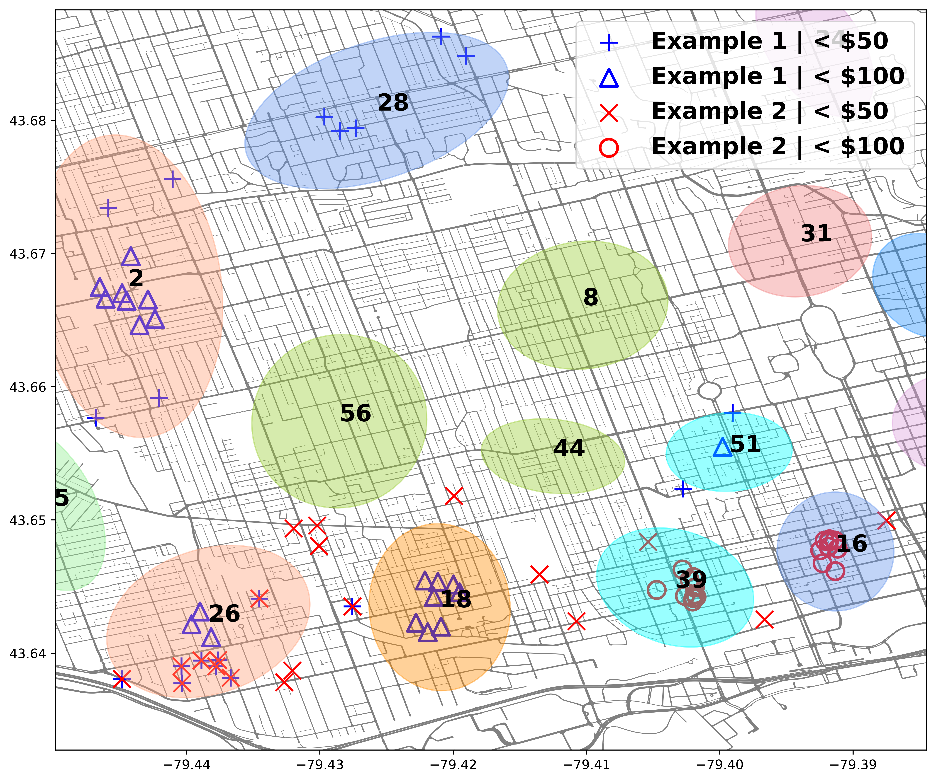
Results - Toronto
Example 1: [‘hipster’, ‘hippy’, ‘art’]
Example 2: [‘clubs’, ‘nightlife’]
Cluster | Scr 1 | Scr 2 | # listings | Avg. Price | Neighborhoods | %
2 | 6.6 | 2.3 | 279 | $101.33 | Dovercourt-Junction | 69
 |  |  |  |  | Corso Italia-Davenport | 21
16 | 2.8 | 5.0 | 794 | $204.44 | Waterfront Communities | 94
18 | 6.8 | 3.8 | 487 | $177.35 | Little Portugal | 37
 |  |  |  |  | Niagara | 33
 |  |  |  |  | Trinity-Bellwoods | 19
26 | 6.1 | 4.2 | 319 | $125.96 | Roncesvalles | 40
 |  |  |  |  | South Parkdale | 38
 |  |  |  |  | Little Portugal | 18
28 | 4.1 | 1.6 | 125 | $119.88 | Wychwood | 53
 |  |  |  |  | Humewood-Cedarvale | 22
39 | 3.5 | 5.1 | 769 | $199.43 | Waterfront Communities | 68
 |  |  |  |  | Niagara | 20
44 | 3.1 | 3.7 | 174 | $141.52 | Trinity-Bellwoods | 53
 |  |  |  |  | Palmerston-Little Italy | 38
51 | 6.4 | 1.9 | 250 | $122.03 | Kensington-Chinatown | 98

Slide 4
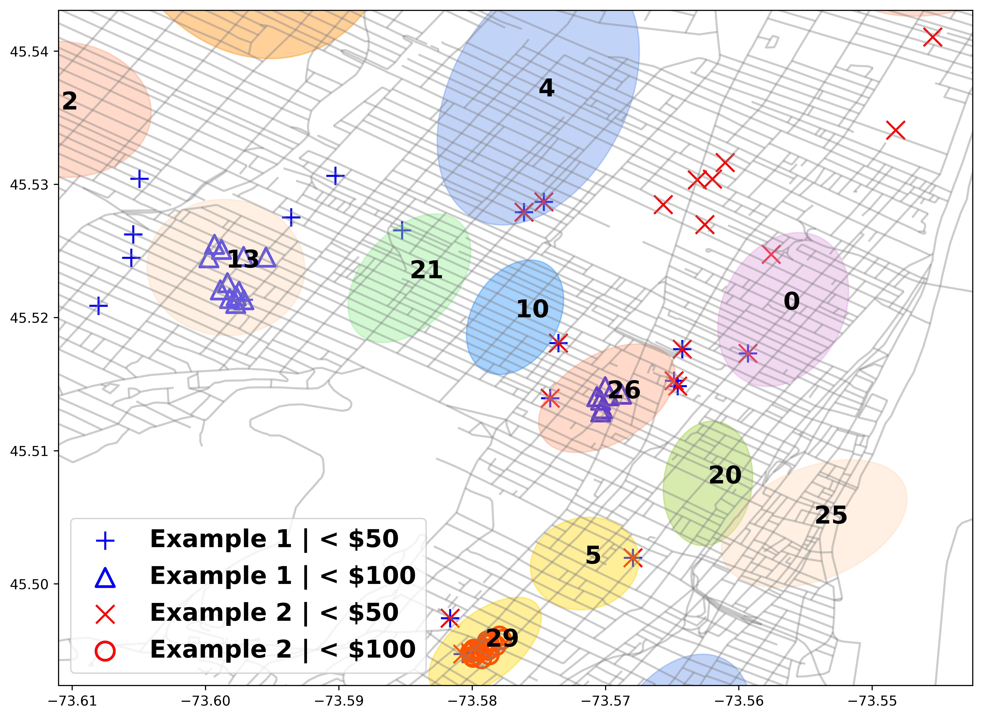
Results - Montreal
Example 1: [‘hipster’, ‘hippy’, ‘art’]
Example 2: [‘clubs’, ‘nightlife’]
Cluster | Scr 1 | Scr 2 | # listings | Avg. Price | Neighborhoods | %
0 | 4.5 | 7.4 | 787 | $109.20 | Ville-Marie | 100
5 | 5.8 | 8.8 | 325 | $186.20 | Ville-Marie | 76
 |  |  |  |  | Le Plateau | 24
13 | 10.3 | 5.3 | 603 | $122.17 | Le Plateau | 77
 |  |  |  |  | Outremont | 14
20 | 8.0 | 6.4 | 453 | $158.07 | Ville-Marie | 100
21 | 6.6 | 5.5 | 691 | $115.44 | Le Plateau | 99
25 | 5.3 | 7.0 | 420 | $187.64 | Ville-Marie | 98
26 | 8.3 | 8.2 | 823 | $159.81 | Le Plateau | 70
 |  |  |  |  | Ville-Marie | 30
29 | 6.4 | 9.3 | 728 | $125.02 | Ville-Marie | 99

Slide 5
Future directions
Improve the Recommendation System
More sophisticated word embedding
Capture trends via temporal information
Extend the System by utilizing more data
Include many cities by scrapping Yelp, Airbnb and possibly Instagram
Identify activities that are associated to specific neighborhoods
Deploy a Destination Recommendation component

Slide 6
Thank you!

Slide 7
Outline
STEP 1
STEP 2
STEP 3
Yelp reviews
Yelp business data
User provided keywords
Sentiment Analysis
Geographical Clustering
Vectors U1, U2 in TF-IDF 1,2
Positive Yelp reviews
TF-IDF 1
For cluster i:
Vectors V1(i), V2(i) in TF-IDF 1,2
Fit a 2D Gaussian: G_{i}(.)
For cluster i similarities:
V1(i) - U1 and V2(i) - U2
Combine: Uscore(i)
Airbnb neighborhood description
TF-IDF 2
Recommendations
Pick N Airbnb listings with:
max Σ_{i} G_{i}(x)*Uscore(i)
Airbnb listings data

